Slide 1
Essential Question:
Why is historiography important and how can it be used?

Slide 2
Historiography- the study of how history is written & its various perspectives / biases

Slide 3
Central idea:
Facts are integral to the study of history, but equally important is the meaning we give historical information

Slide 4
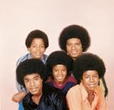

Example

Slide 5

Motown Remixed

Slide 6
P
E
R
S
I
A
N

Slide 7
Periodization
Catagorizes / Organizes history
Subject to practical constraints
Based on perspective & bias
Reflects historical training / school of thoughts

Slide 8
Dominant Schools of Historiography
Consensus or traditional-
Argues that change results from consensus among various groups in society.
Division & class interest, etc. exist but are not central to the process of change.

Slide 9
Conflict or revisionist-
Opposite view
It views conflict among groups, classes, race, and gender, etc. as central to the process of change.

Slide 10

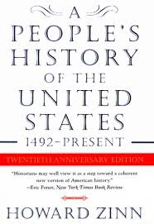
2 Examples

Slide 11

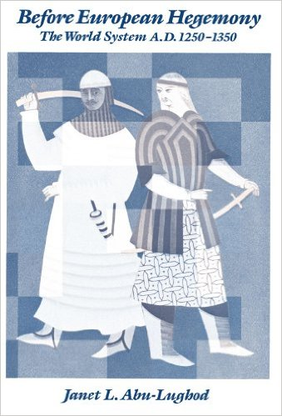
2 Examples

Slide 12
Types of History
Social
Political
Economic
Diplomatic
Military
Marxist / Conflict
Gender
Eurocentric
Afrocentric
Environmental Determinism

Slide 13
World History – Time Periods
c. 8000 BCE – 600 BCE
Technological and Environmental
Transformations
Sometimes called Foundations Period

Slide 14
Organization & Reorganization of
Human Societies
c. 600 BCE –C.600 CE
Also know as the Classical Period

Slide 15
Regional & Transregional Interaction:
c. 600CE – c. 1450
Also know as Post-Classical Period

Slide 16
Global Interactions, c. 1450 –c. 1750
Also known as Early Modern Era

Slide 17
Industrialization & Global Interaction, c. 1750
c. 1900

Slide 18
Accelerating Global Changes & Realignments, c.
1900 – Present

Slide 19
Parallel Developments
Similarities that occur in separate societies, regions etc.
Examples: Neolithic Revolution, Age of Political Revolutions, & Environmental Determinism

Slide 20
Historical Webs
A Framework for Analysis

Slide 21
Interconnections that occur at different levels throughout history and help to form a greater understanding of exchange, interaction, transmission, and syncretism throughout world history.

Slide 22
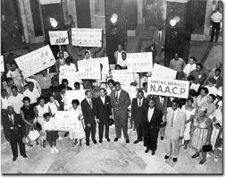
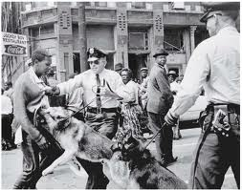
Example Civil Rights Movement & Decolonization
Metropolitan Web

Slide 23
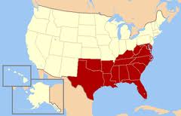
Regional Web

Slide 24
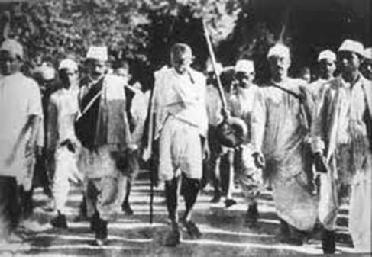
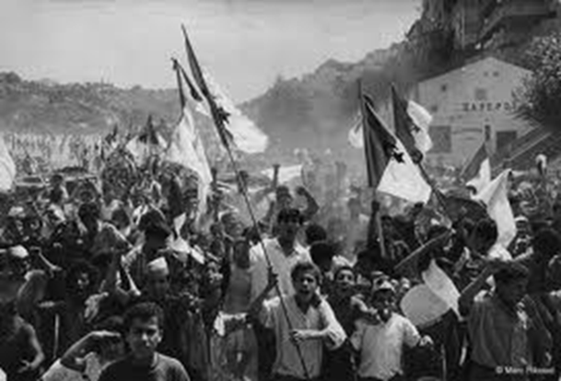
Cosmopolitan Webs

